Slide 1
Microtransit Discussion
Ritun and Siwei

Slide 2
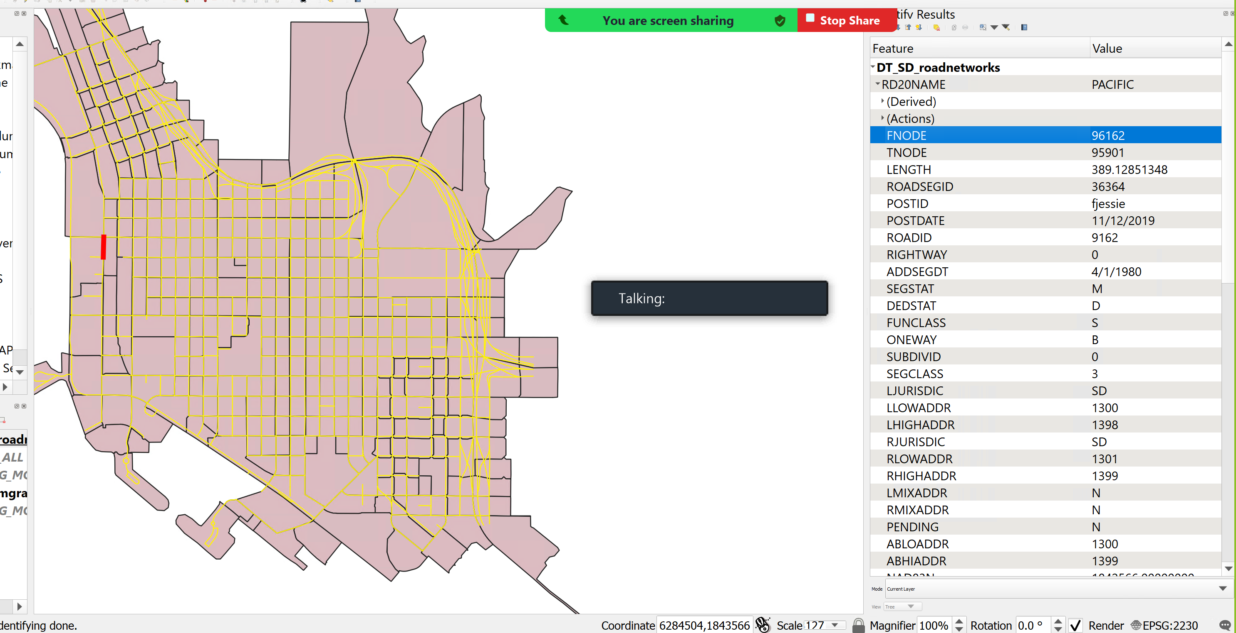
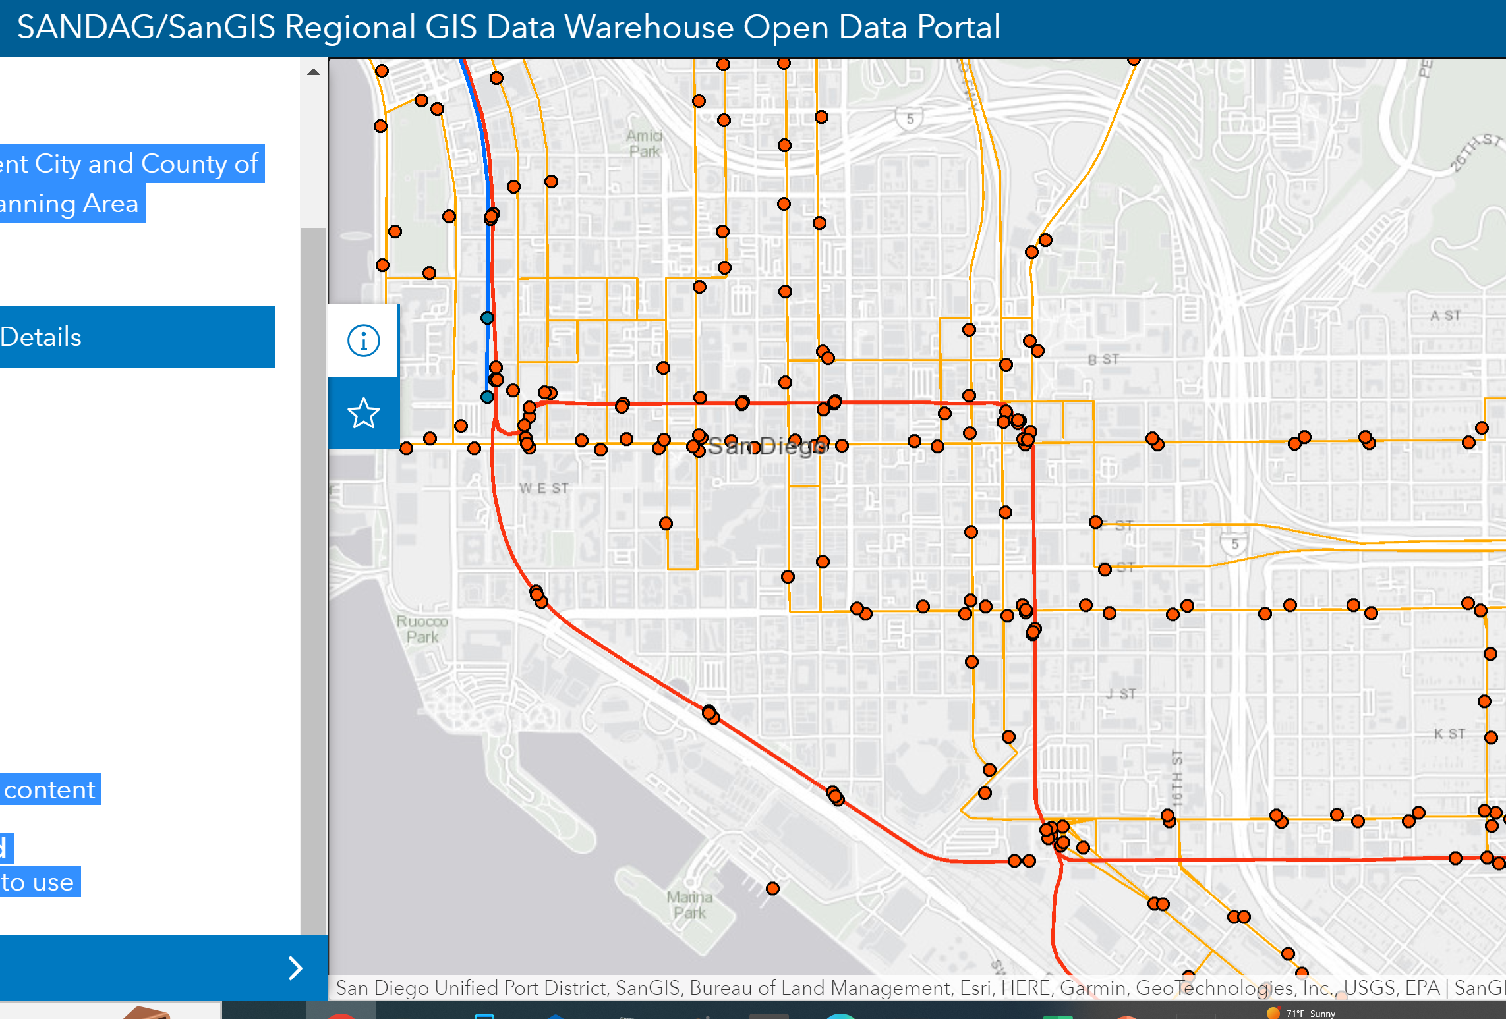
96162
10234
10234

